Slide 1
READING AT SEGHILL FIRST SCHOOL

Slide 2
The teaching of English is a central part of our work at
Seghill First school. English unites the skills of communication
(speaking and listening, reading and writing) and we believe that the acquisition of these skills is an entitlement of all children.
The teaching of English at Seghill First school is relevant to the
whole of the National Curriculum. We believe that English skills should be taught to all children and applied to a high standard.

Slide 3
In July 2021 the Department for Education released
The Reading Framework – teaching the foundations of literacy.
At the heart of this is the importance of systematic phonics teaching.
At Seghill First School we already have a systematic phonics teaching
programme in place which is Read Write Inc. This is one of the approved phonics programmes by the DfE.

Slide 4
With the knowledge that we had a great phonics programme in place we turned our attention to the books we were sending home with the children. These books needed to work alongside the RWI programme and support the children with their in school phonics teaching at home.
We therefore decided to overhaul our reading books and invest in the RWI book bag books which match perfectly alongside the groups the children are working in in school.

Slide 5
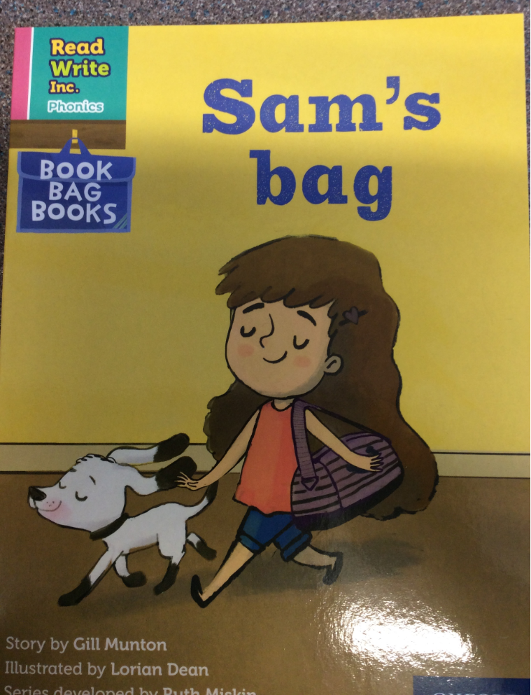
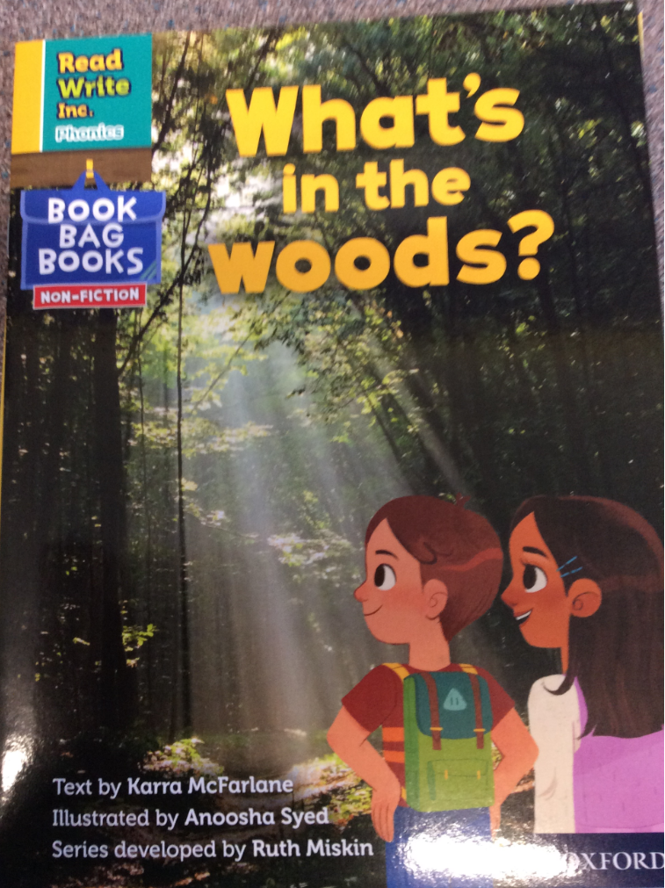
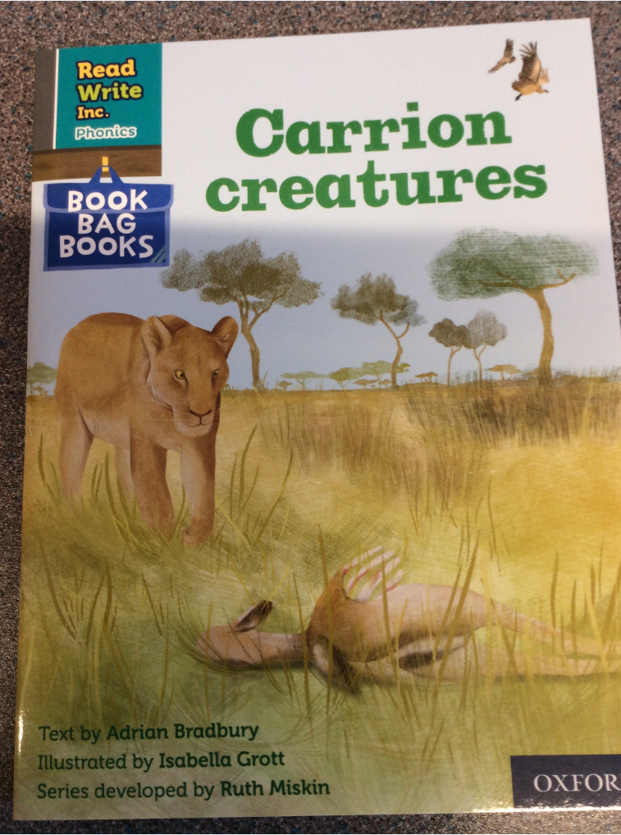
Book Bag Books
Here are some ways you can use the Book Bag Books at home to support your child.

Slide 6
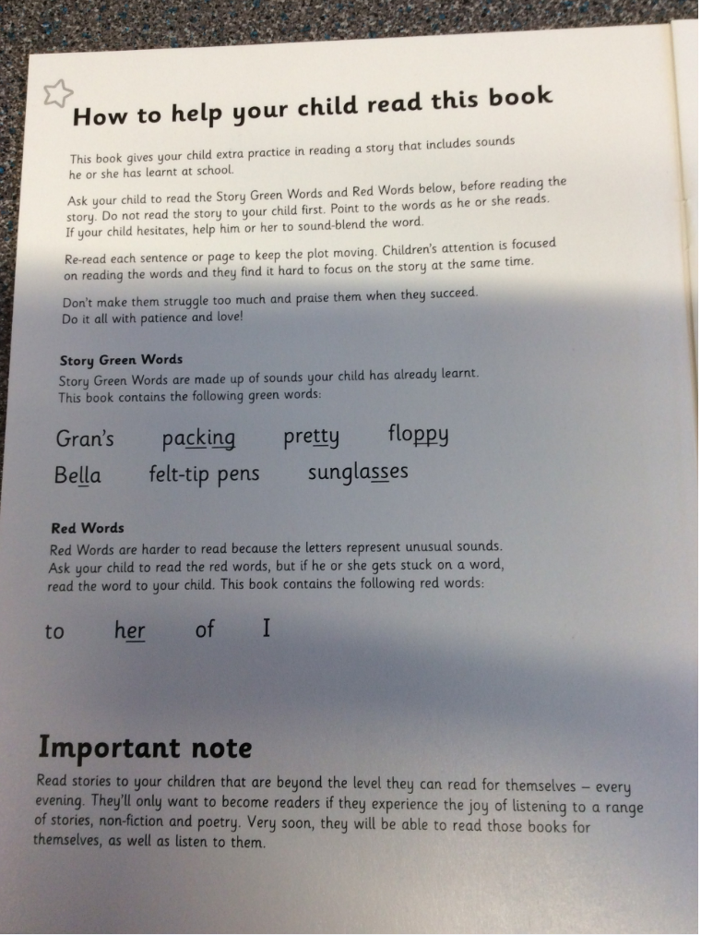
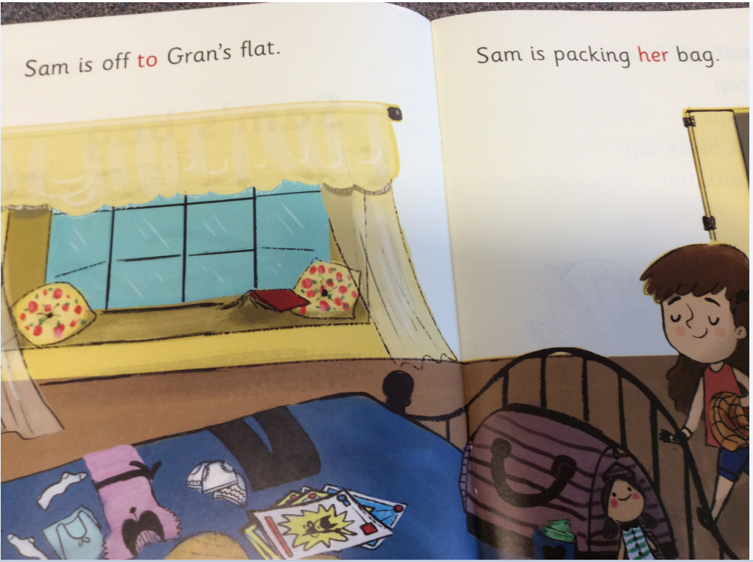
Book Bag Books
All of the books start with a section on
Green and Red words.
Green words are ones that your child can sound out
and blend together to read.
Red words are those that are tricky and don’t follow
the sounding pattern. They need to be taught and remembered.
In the earlier stages the red words are shown in red in the book and it is important to discuss the tricky part with your child and tell them what it says if they are unsure.

Slide 7
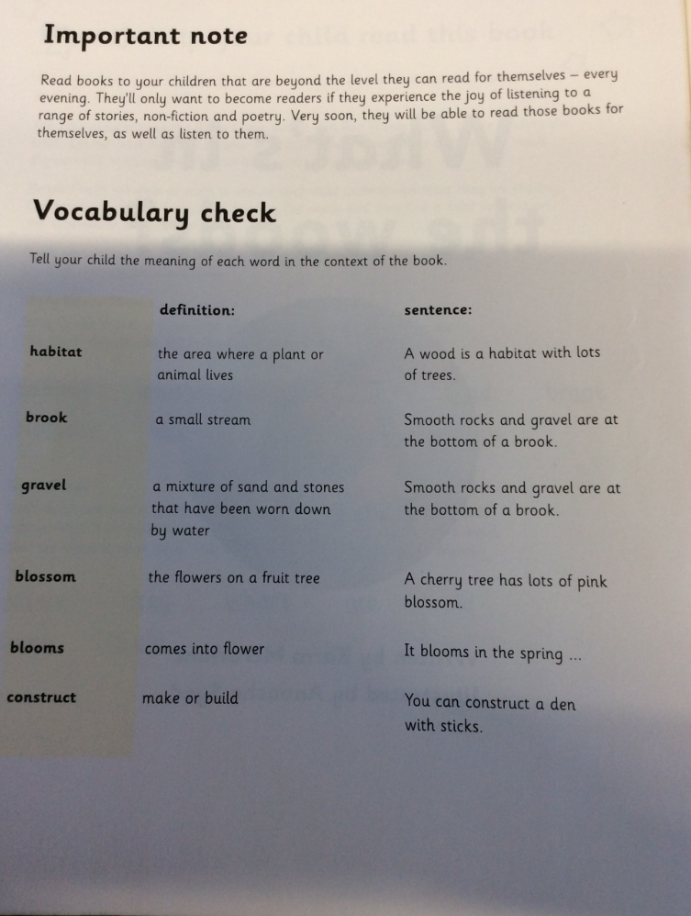
Book Bag Books
The books progress to later contain a vocabulary check. These are words the children may come across in the text and be unsure of as they are subject specific.
It is important that the children have a chance to look at these words and discuss what they mean to help them with their fluency and understanding when reading the book.

Slide 8
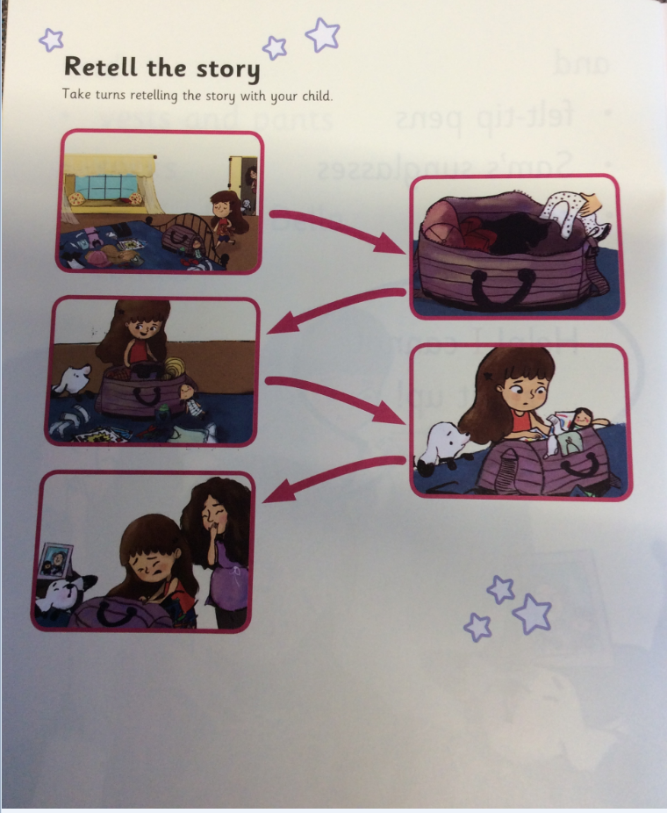
Book Bag Books
Retelling is a strategy readers use to think about what they are reading. When we retell a story, we tell the important parts, in the right order. This helps us to understand the story better and remember it longer. Good readers stop and retell throughout the text to help them understand the story.

Slide 9
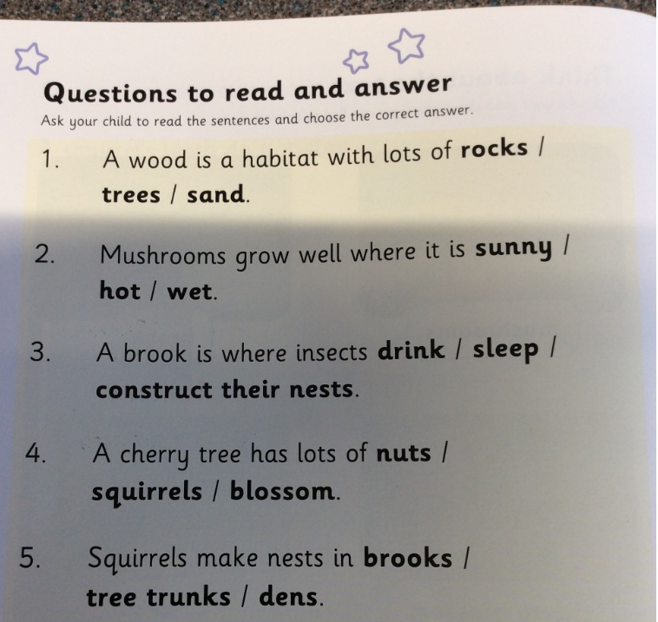
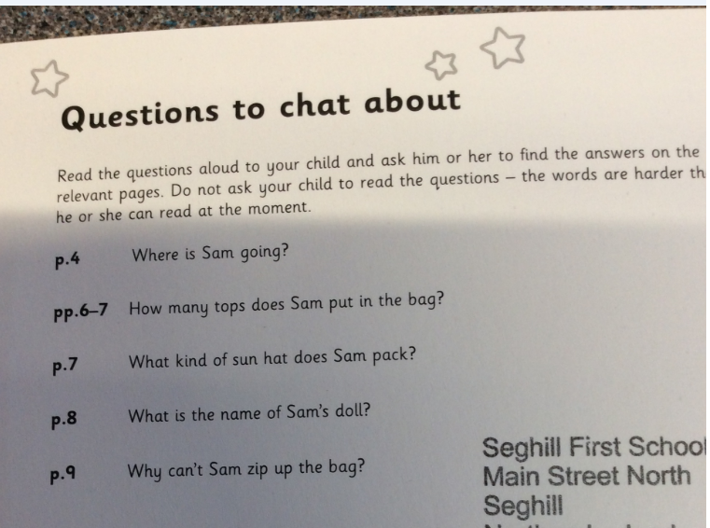
Book Bag Books
At the back of the book there are questions to read and answer – a child should be able to do these with some prompt.
There are also some questions to discuss. These questions have page numbers and the child should be able to refer back in the book and find the answers in the text.

Slide 10
Developing fluency
Developing fluency is not just about how fast a child can read, but it is also about how accurate they are with the words they are reading.
We are placing a big emphasis on children reading the books they are given several times so that they develop fluency.
In the DfE guidance it says: Children must first work out a word by sounding and blending. Most of them have to do this several times before they can read it accurately ‘at a glance’. Re-reading a text, therefore, gradually increases the number of words in it that they can read ‘at a glance’.
On each re-read, their familiarity with a story deepens and, with that, comes greater emotional engagement.

Slide 11
Expectation of progression in phonics
 | Autumn term | Spring term | Summer term
Reception | Ditties 1 - 12 | Ditties 13 - 42 | Set 1 Green books
Year 1 | Set 2 Purple books | Set 3 Pink books | Set 4 Orange books
Year 2 | Set 5 Yellow books | Set 6 Blue books | Set 7 Grey books
Year 3 & 4 | Children in Year 3 & 4 should have finished their RWI journey and be using and applying their knowledge.

