Slide 1
Phonics Screening Check 2022
Information for Parents

Slide 2
What is the phonics screening check?
The phonics screening check is a short assessment to check if individual children have learnt phonic decoding to an appropriate standard. This is one way the children learn to read.
The check consists of 40 words, 20 real words and 20 nonsense words that your child will be asked to read one-to-one.
It helps us to identify the children who need extra help so we can give more support to improve their reading skills.

Slide 3
How is the check structured?
It will be a short, simple screening check to make sure that all children have grasped basic phonic skills.
Half of the words cover phonic skills which tend to be covered in Reception, and half of the words are based on Year 1 phonic skills.
The check will contain a mix of real words and ‘alien words’ (nonsense words). Your child will be told before the check that there will be alien words that he or she has not seen before.
We use ‘alien words’ when we teach phonics, so your child should be know what to look out for.

Slide 4
Who is it for?
The screening check is for all Year 1 pupils and children in Year 2 who previously did not meet the standard of the check in Year 1.
Is it compulsory?
It is a statutory requirement for all schools to carry out the screening check.

Slide 5
When does the Phonics Check happen?
The phonics screening check takes place in June of each year.
We will be completing our phonics screening check WB 6th June.

Slide 6
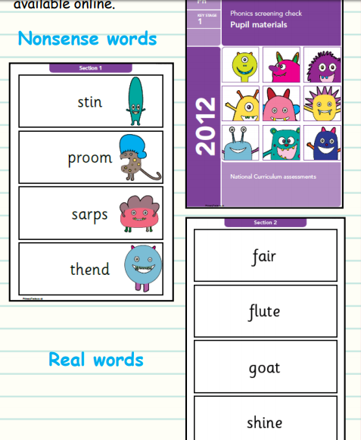
Sample materials are available on the education.gov.uk website. Below is an example from the 2012 Phonics Screening Test.
All papers from previous years are online.

Slide 7
What skills do children need to meet the standard of the phonics screening check?
All children need to be able to identify sounds associated with different letters, and letter combinations, and then blend these sounds together to correctly say the word on the page.
The same skill is needed whether the word is a real word or a non-word. The words gradually get harder through the check as the combinations of letters become more complicated.
Children will also need to recognise ‘alternative’ sounds in real words, such as ‘y’ in the word happy having the pronunciation ‘e’.

Slide 8
What happens with the scores?
After the check has taken place in June, schools will be given the ‘pass’ mark. The pass mark has always been 32 out of 40.
Schools do not publish data but they inform parents if their child is working at the expected level (scoring the pass mark or above) or if they are working towards the expected level (scoring below the pass mark).
Schools use the information to find ways to support the children who do not reach the score and the result will provide teachers with information to help develop the child’s skills in phonics.

Slide 9
Is it stressful?
The assessment is age-appropriate, with children sitting with a teacher who they know. Reading one-to-one with a teacher is a familiar activity for Key Stage 1 children. It should be an enjoyable activity for children and takes no more than a few minutes.
We will say something to the children like “come and do a job with me”, rather than saying “you are having a test”.

Slide 10
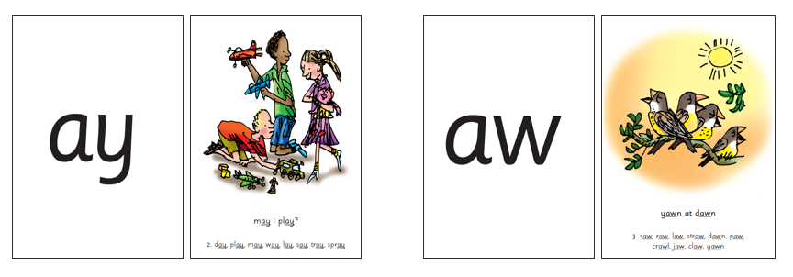
How do we teach phonics?
We teach children sounds linked to phrases e.g. may I play? And yawn at dawn.
Many sounds have 2 or more letters to make the sound and we call these special friends.

Slide 11
How do we teach phonics?
We teach children to read both real and nonsense words using the routine ‘Special Friends’, ‘Fred Talk’, ‘read the word’.
Children spot the ‘Special Friends’ (two/three letters that make one sound), Fred talk the word, and then read the word as a whole.
For example, ‘sh’, ‘sh-i-p’, ‘ship’.

Slide 12
How can I help at home?
Practice a mix of real and ‘alien words’

Slide 13
Examples of alien words

Slide 14
