Slide 1
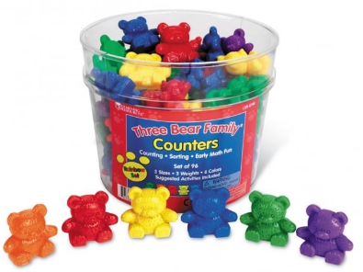
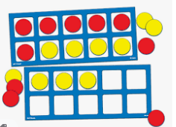
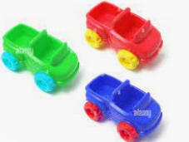
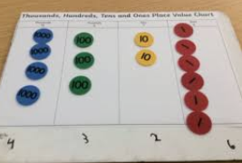
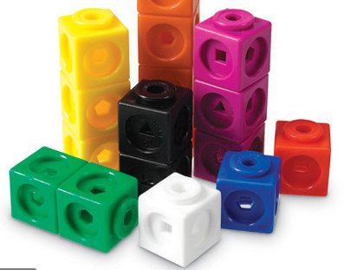
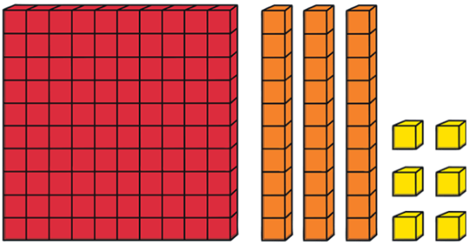
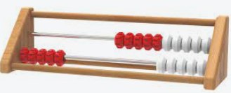
Learning maths
at Seghill First School

Slide 2
Virtual Coffee Morning - Maths
Representations
Approach to Learning
Mastering Early Number (Early Years - Year 2)
Numbots
TTRockstars
1 minute maths
Helping your child at home
Calculating

Slide 3
Virtual Coffee Morning - Maths
Representations
In all our maths lessons at Seghill First School the children have access to and regularly use a variety of representations and structures. Children from Nursery to Year 4 will use and be familiar with some or all of the following types of mathematical equipment known as manipulatives. The purpose of this equipment is to help reveal mathematical structures and help children ‘see and live the maths’.
Toys, objects and Compare Bears | Straws | Numicon | Tens frames and double sided counters
Rekenreks | Cubes | Base Ten (Dienes) | Place Value Counter

Slide 4
Virtual Coffee Morning - Maths
Approach to Learning
We use an approach to learning in maths called ‘teaching for mastery’.
What is teaching for mastery?
Children achieve deep, long-term and secure understanding of numbers
‘Teaching for mastery’ gives children the best chance of mastering maths.
The approach gives children a solid understanding of the maths so that they have the skills to tackle problem solving tasks.
Teaching for mastery does not follow the belief that some children ‘just can’t do maths’.
Children are encouraged to believe that ‘I can do maths’.
Children are taught through whole-class interactive teaching, where the focus is on all pupils working together on the same lesson content at the same time so that they all master concepts before moving on.
Practice is an important part of learning, but the practice used is intelligent practice - this means tasks are planned carefully for children to gain deep understanding.
Developing a deep knowledge of the key ideas is key to help children in their future learning.
Learning key facts such as multiplication tables and addition facts within 10 so that they are automatic helps children free up working memory and allows them focus on new concepts.

Slide 5
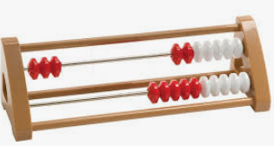
Virtual Coffee Morning - Maths
Children use a special piece of equipment called a rekenrek. This helps children see how numbers are made and are a particularly good way to help children secure their number bonds to 20.
They may say the stem sentence:
“3 needs 7 to make 10”
And represent it on the top row of their Rekenrek like this.
Mastering Early Number
This is a national programme that we are delivering to our children from Reception to Year 2.
What does it involve in Early Years?
A 15 minute interactive maths session delivered to the whole class followed by small group work, access to carefully planned activities within the Early Years setting and maths concepts built in to the children’s routines such as lining up.
Representations including physical resources and images are used to help children see patterns
Special sentences called stem sentences are used to help children explain the maths.
What does it involve in Year 1 and 2?
A 15 minute interactive maths session in addition to the children’s daily maths lessons.
Representations including physical resources and images are used to help children see patterns.
Special sentences called stem sentences are used to help children explain the maths.

Slide 6
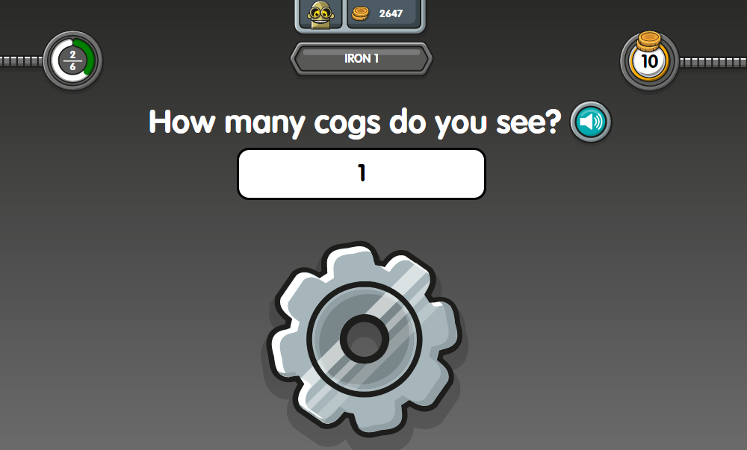
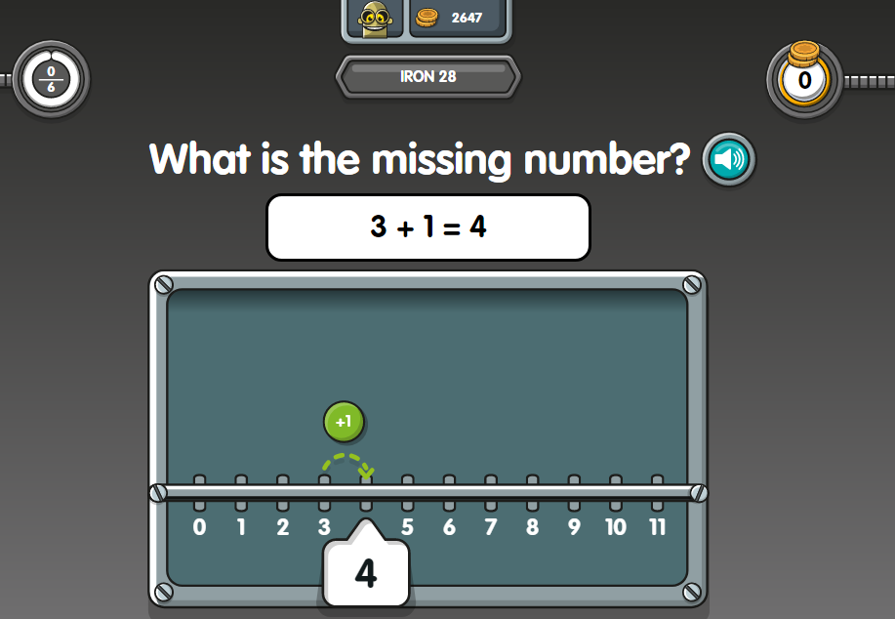
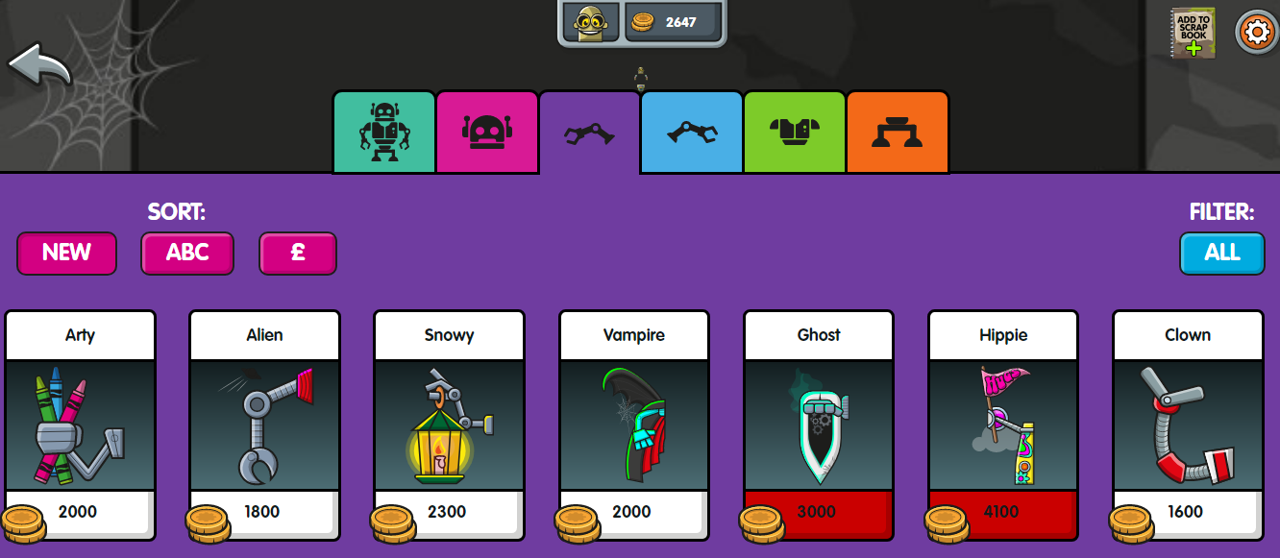
Virtual Coffee Morning - Maths
Numbots is an interactive virtual platform where children can:
Play fun interactive games to learn their number facts.
Play in story mode or challenge mode
Earn coins, rewards and badges
‘Buy’ extra parts for their robots using their earned ‘coins’
children must:
Start at the easiest level and work up to unlock levels

Slide 7
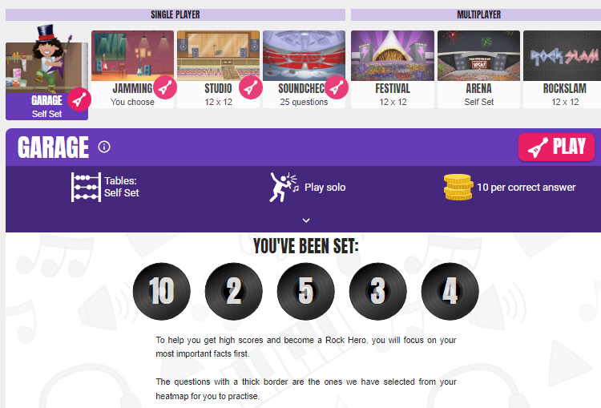
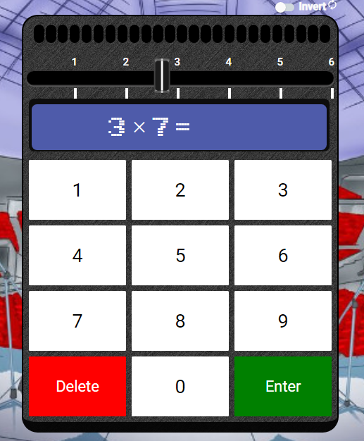
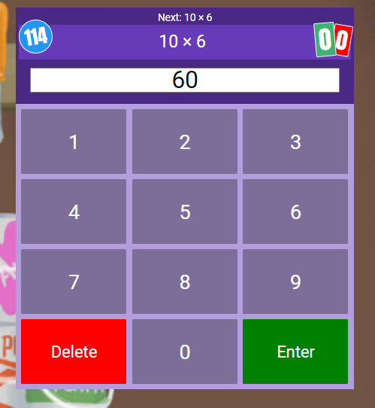
Virtual Coffee Morning - Maths
TT Rockstars is an interactive virtual platform where children can:
Play interactive games to learn their times tables.
Choose options where they set the tables they want to learn.
Complete challenges set by their teacher
Compete against other children
Earn coins and rewards
Check progress on the leaderboards

Slide 8
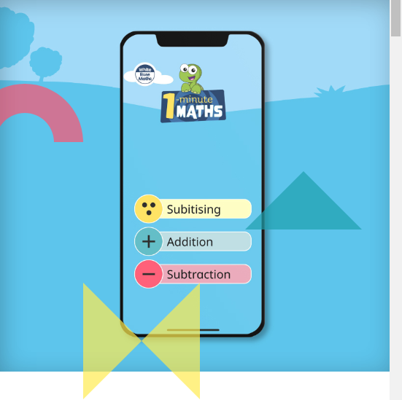
Virtual Coffee Morning - Maths
I Minute Maths
Who is it for?
This first version of the app is aimed at Key Stage 1 pupils, and focuses on adding and subtracting – and on ‘Subitising’. The free mobile app is available for Apple/iOS, Android and Kindle.
How does it work?
1-Minute Maths offers children engaging and easily accessible practice in basic number. There’s no specific route or starting point. Having chosen a topic, each user answers a series of randomly generated questions (a different set of questions every time means they learn the concept, not a sequence of answers).
When the one minute’s up, the questions are automatically marked and presented on a breakdown screen, giving instant feedback on how they’ve done. If they’re struggling with a question, a ‘Hint’ button reformats the question as a familiar manipulative display that mirrors the approaches used in the White Rose Maths schemes of learning.

Slide 9
Virtual Coffee Morning - Maths
Helping your child at home
With important emphasis of children securing basic number facts, there are a number of ways that you can support your child at home.
Sit with them when they complete their homework and talk about the work they are doing. Ask them to explain what they are doing and how it links to work in school.
Help your child log on to Numbots as often as possible for short periods of time. Their login details are on a sticker in their reading record.
For children in KS2, encourage them log on to Times Tables Rockstars as often as possible for short periods of time. Their login details are on a sticker in their reading record and is the same as their Numbots login.
Download the brand new ‘1 minute maths’ App from White Rose Maths on Google Play or at the App Store or follow the link below
https://whiterosemaths.com/resources/1-minute-maths#download

Slide 10
Virtual Coffee Morning - Maths
Calculating and using the representations
Calculating refers to the four number operations of adding, subtracting, multiplying and dividing.
If you would like to read more about calculating with manipulatives and the approach we use please:
Follow this link to the White Rose Maths website. Scroll down and then click on the link titled calculation policy.
https://whiterosemaths.com/resources?year=year-1#supportingmaterialsAddition%20and%20subtraction%20calculation%20policy%20(1).pdf
OR
email any questions to anna.bell1@school360.co.uk

Slide 11
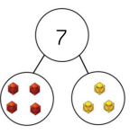
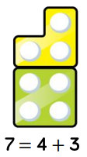
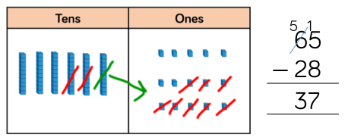
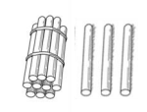
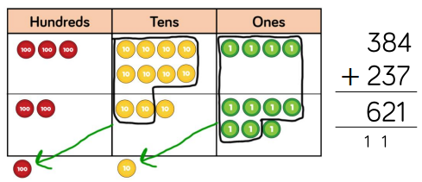
Thank you for taking the time to to find out about learning maths at Seghill First School

