Slide 1
Funky phonics
Mrs Askew and Mrs Kembrey
Nursery and Reception

Slide 2
Who is Read Write Inc. Phonics for?
Notes:
Read question.

Slide 3
Read Write Inc. Phonics
Nursery – Y1 sometimes into Y2 (KS1)
Older children who need to‘catch-up’
Children new to English
Notes:
Using Read Write Inc. Phonics will ensure all children who come to our school learn to read:
Nursery – Y1
Older pupils who have struggled to learn to read and need to ‘catch up’
EAL pupils
Children with SEN and dyslexia also learn to read using this programme.
Teaching and learning focuses on what children already know and what they need to learn next in order to make best possible progress - by stage not age.

Slide 4
Nursery
Nursery start with listening skills
Use of musical instruments, following instructions, copying a rhythm or beat
Using Letters and sounds as a scheme before the children start RWI
The children work in 2 small groups

Slide 5
What is Read Write Inc. Phonics?
Notes:
Read question.

Slide 6
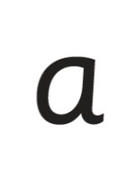
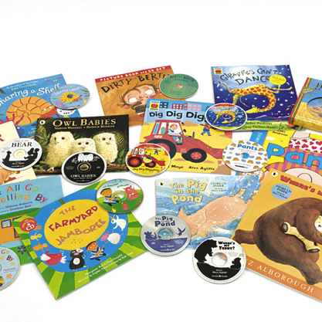
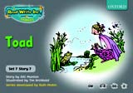
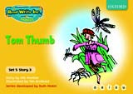
Systematic approach
sat
mat
p
d
sad
i
t
n
Notes:
Read Write Inc. Phonics is a programme that uses systematic phonics to teach all children to read.
It lasts two years for most children - if they start to learn to read in the Reception class.
(There are some children with learning difficulties who spend longer on the programme.)
Click – We teach the sounds first – in a specific order.
Click – We then teach your children to blend those sounds together in order to read words
Click – The children read words in the matched Storybooks. Each Storybook is carefully matched to the sounds they can already read - setting them up for success.
Click – We read to children ‘real’ books’. Once they have learnt to read, they will be able to independently read these books for themselves.

Slide 7
Phonics
Sounds
All words are made up of sounds e.g.
in ‘mat’ we have the sounds ‘m’, ‘a’, ‘t’.
Graphemes
A grapheme is another name for the letters we use to write the sound.
Notes:
The English language is very complex.
Phonics is the method of teaching reading through the identification of sounds and graphemes.
Click. All words are made up of sounds e.g. in ‘mat’ we have the sounds ‘m’, ‘a’, ‘t’.
Click A grapheme is another name for the letters we use to write the sound. Write the letters ‘m’ ‘a’ ‘t’ in the air as you say the sounds.
We teach phonics so that your children will have the tools to read any word.

Slide 8
Pure Sounds
Notes:
We teach using pure sounds.
We use pure sounds (‘m’ not’ muh’, ’s’ not ‘suh’, etc.) so that your child will be able to blend the sounds into words more easily.
Children need to know sounds – not letter names – to read words.
This video of Sylvie – available on the website – demonstrates how to talk in pure sounds. Play video.

Slide 9
English alphabetic code
44 sounds
Over 150+ graphemes
One of the most complex alphabetic codes in the world.
Notes:
In English we have more than 150 ways to represent 44 sounds, using the 26 letters in the alphabet.
This means we have to group letters together to write some sounds. Show with a grapheme such as ‘igh’.
This makes our language one of the most complex in the world!

Slide 10
Speed Sounds chart
Notes:
We use this Speed Sounds chart in Phonics lessons.
It shows the most common graphemes for each sound.
Each box is a sound box showing different ways to read and write the sound. Demo the ‘f’ sound box with examples of words ‘fun’, ‘huff’, ‘photo’ and the ‘or’ sound box with examples of words ‘or’, ‘door’, ‘more’, ‘dawn’, ‘author’.

Slide 11
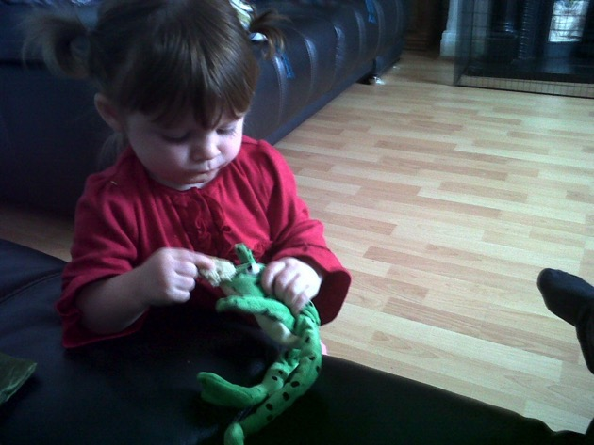
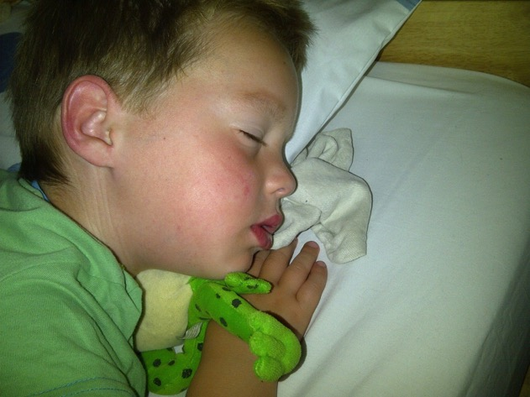
Fred Talk
Notes:
This is Fred.
He is a frog who can only speak in sounds, and we call this Fred Talk. For example ‘m’ ‘a’ ‘t’, ‘l’ ‘u’ ‘n’ ‘c’ ‘h’.
He helps children sound out words so they can read and spell.
MTYT some examples with the parents. For example ‘m’ ‘a’ ‘t’ mat, ‘s’ ‘a’ ‘t’ sat.
Click. Fred is our friend!

Slide 12
What should my child read at home?
Notes:
Read question.

Slide 13
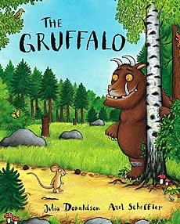
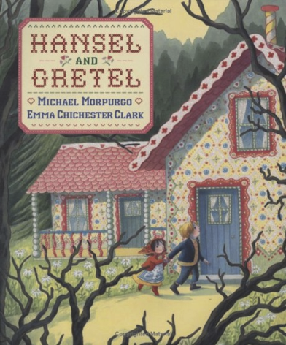
Picture books
Notes:
Visit library
Picture books
Reading books

Slide 14
How can I help at home?
Notes:
Read question.

Slide 15
Storytime
Read to your children
Ask lots of questions and share opinions
You're never too old, too wacky, too wild, to pick up a book and read to a child.
Dr Seuss
Notes:
One of the most important things you can do as a parent at home is read higher level texts to your child.
This helps develop an enjoyment for stories and the motivation for learning to read themselves.
Ask questions and share opinions about what you read to engage them in discussion, get them thinking about what they read and develop vocabulary.
Click and read.

Slide 16
Talking
Talk to your child as much as possible and ‘feed’ them new and ambitious vocabulary.
“Let’s eat our lunch now.”
“Let’s munch our lunch now.”
“Let’s scoff our lunch now.”
“Let’s devour our lunch now!”
You’re looking ... not just... but...
Notes:
Click through and read examples to parents.
Use ambitious vocabulary with your children and encourage them to use these words for themselves in both their speech and writing. Build interesting sentences with your child.
A rich vocabulary is essential for high levels of comprehension. The more words your child has in his/her head when they come to school, the quicker they will understand when they read, e.g.
“You’re looking pleased… not just pleased but delighted!” (thrilled/ecstatic/euphoric! Etc)

Slide 17
Sound book
Practise makes perfect – daily with children it only taken a few minutes
New sounds added each week. Practise each sound as much as possible.
Letter formation. Cut and stick or drawing objects beginning with each letter sound.

Slide 18
Online resources available
Ruth Miskin Parents’ Page:
https://ruthmiskin.com/en/find-out-more/parents/
Ruth Miskin Facebook:
https://www.facebook.com/miskin.education
Free e-books for home reading:
http://www.oxfordowl.co.uk/Reading/

Slide 19
Any other questions

