Slide 1
Handwriting at Seghill First School

Slide 2
Children must be able to write with ease, speed and legibility. If they have difficulty, this will limit fluency and inhibit the quality and quantity of their work. Cursive handwriting teaches pupils to join letters and words as a series of flowing movements and patterns.
The style is quick and easy to learn, particularly when it is practised from an early stage. Pupils will learn to form individual letters appropriately and accurately first and then by term 3 of Year 2 pupils will begin to join their handwriting.
Handwriting skills are taught regularly and systematically through the use of the Nelson Handwriting Scheme.

Slide 3
How handwriting is taught throughout the school
Foundation Stage
In the Foundation Stage children take part in activities to develop gross and fine motor skills and recognition of patterns.

Slide 4
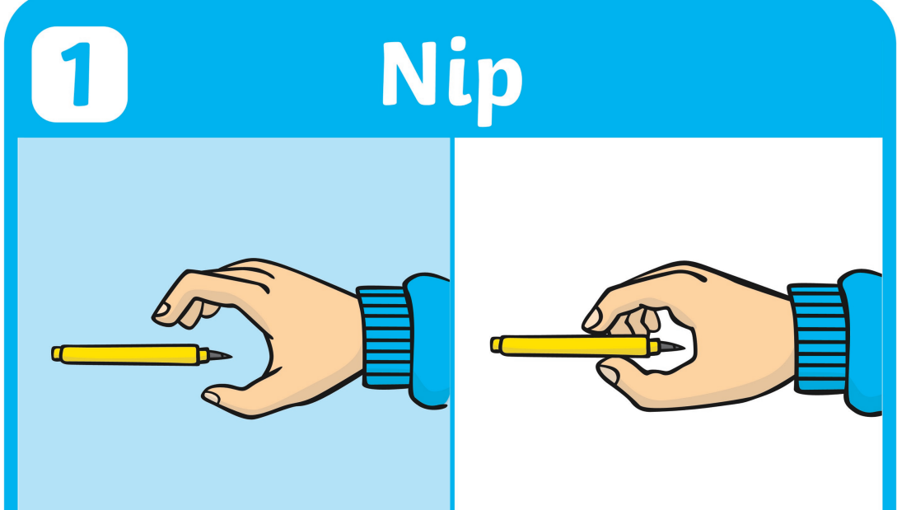
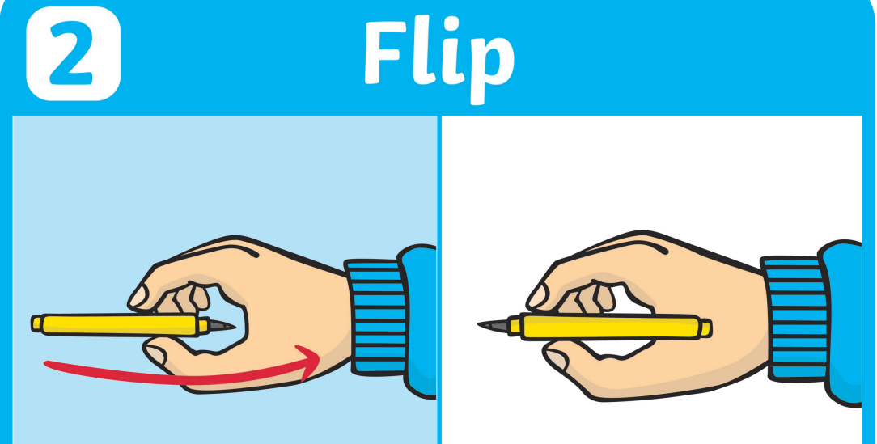
Foundation Stage
Pencil grip is taught specifically using the prompt ‘nip, flip,grip’ and children take part in activities such as the use of nipping tools to strengthen the muscles associated with this skill.

Slide 5
Foundation Stage
Individual letter formation is taught, modelled and practised in working towards the objectives for Key Stage 1.
Children will achieve the above through a series of programmes:
Write from the start
Dough Disco
Squiggle while you Wiggle
RWI

Slide 6
KS1
In accordance with the National Curriculum 2014 the children are taught how to form both lower case and capital letters and how to join them, whilst still developing fine and gross motor skills with a range of multi-sensory activities.
Handwriting is directly taught regularly outside the literacy lesson but correct letter formation is emphasised during all writing activities. The children are taught to:
Write from left to right and from top to bottom.
Start and finish letters correctly.
Be consistent with the size and shape of letters and the spacing of letters and words.
Have the correct pencil grip (see slide for Foundation Stage).
Find a convenient position for their page.
Have the correct posture and position while writing.

Slide 7
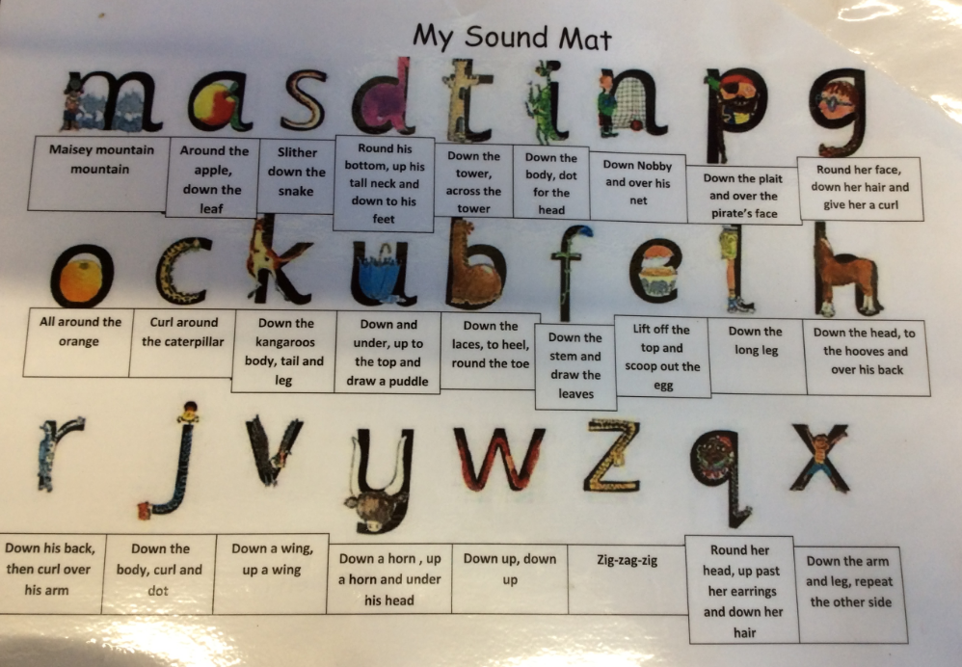
KS1
Pupils will focus on letter formation using the RWI phrases which sits inline with the Nelson font.

Slide 8
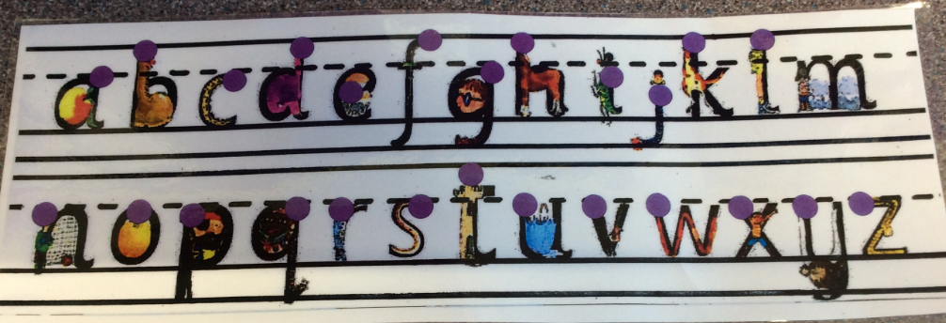
KS1
There will also be a focus on using our guidelined writing books so that children can demonstrate consistent letter size including ascenders and descenders. They will use 12mm lines with a move to
10mm lines by end of year 2.
12mm line
10mm line
Where the letters should sit on the lines

Slide 9
KS2
Children will follow the Nelson Handwriting Scheme to learn to join their writing. The aim is to have earned their pen licence by the end of Year 4 and have moved to lined books without guidelines in preparation for middle school.
We aim for children to:
Achieve a neat, legible style with correctly formed letters in cursive handwriting.
Develop flow and speed.
Eventually produce the letters automatically and in their independent writing.

Slide 10
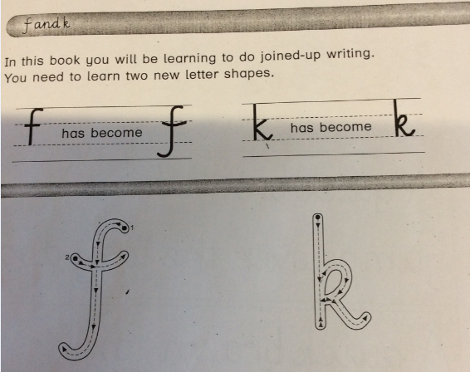
KS2
A couple of change to letter formation happen in KS2. It is important that children know and are taught these changes to enable them to join correctly.

Slide 11
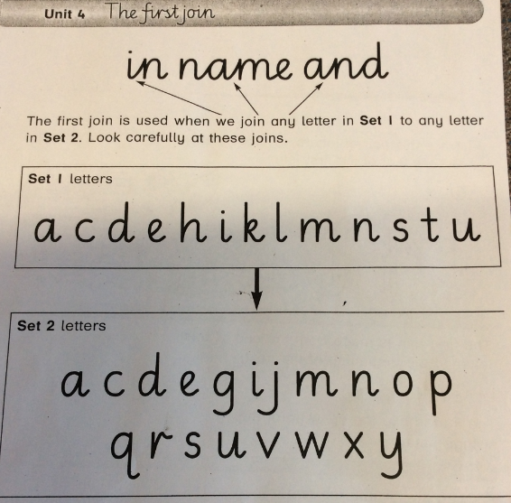
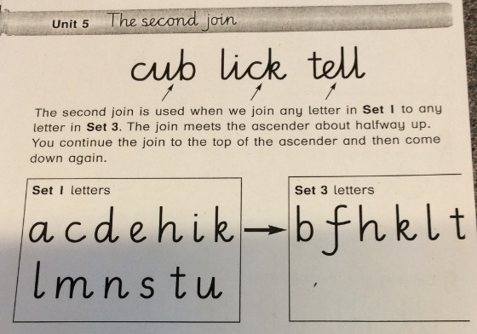
KS2
We then teach the children to join use four different joins. They are as follows:

Slide 12
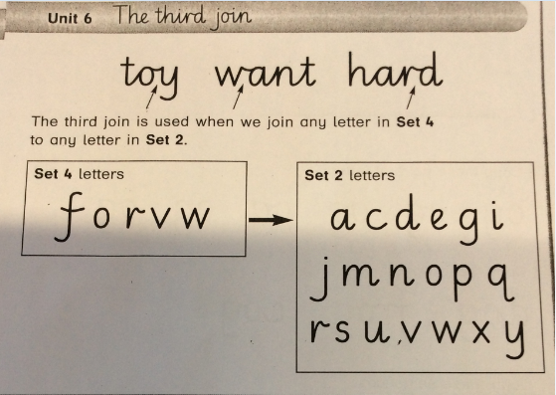
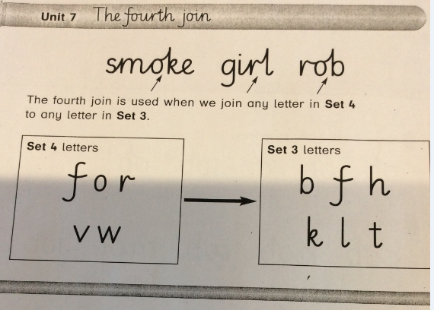
KS2

Slide 13
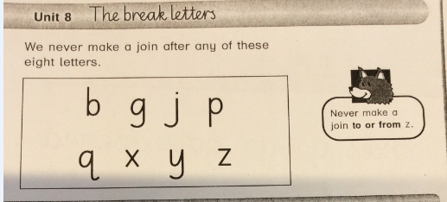
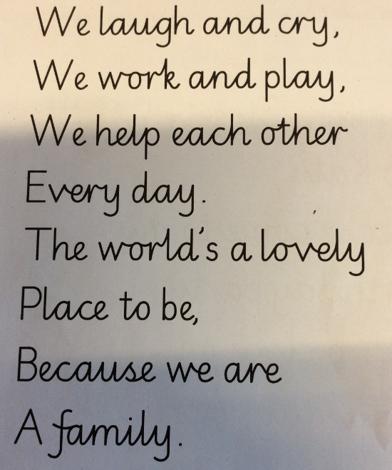
KS2
There are some letters we call break
letters and these are letters we do not join from.
The systematic teaching of these four joins and the break letters will then lead to neat, joined legible handwriting.

Slide 14
Provision for left handed children
Left handed children are encouraged to find a comfortable orientation for their paper, usually slightly to the left of centre of their body, and to have their fingers about 1.5 cm from the point of their pencil.
Left handed children are seated to the left of right handed children to avoid elbows colliding.

